Slide 1
Scientific figures seminar – Part 2
Jérôme Hilaire & William Lamb

Slide 2
Keep the goals in mind
“Remember, in science, message and readability of the figure is the most important aspect while beauty is only an option”
Rougier et al. (2014)
“Ten Simple Rules for Better Figures”

Slide 3

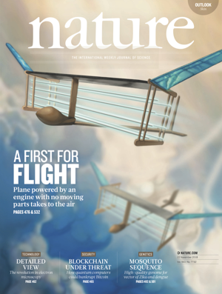
Know your target
OR
“Figures should be in a finished
form suitable for publication. […]“

Slide 4
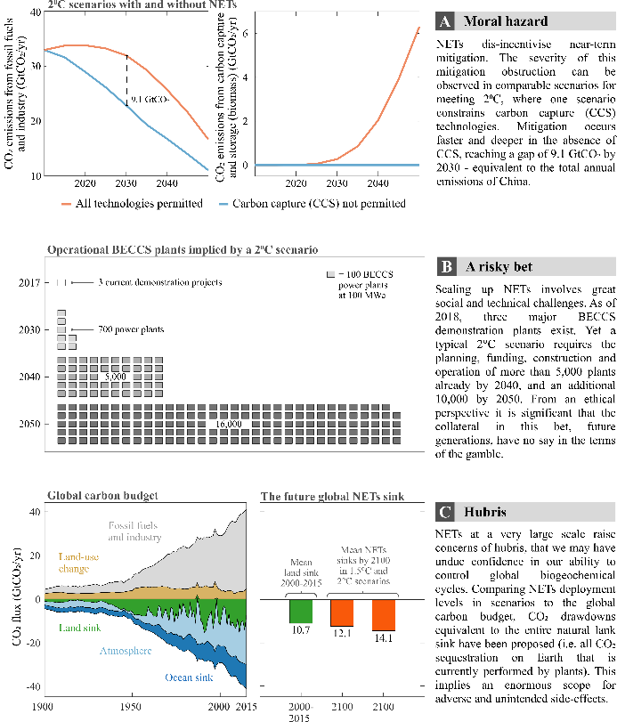
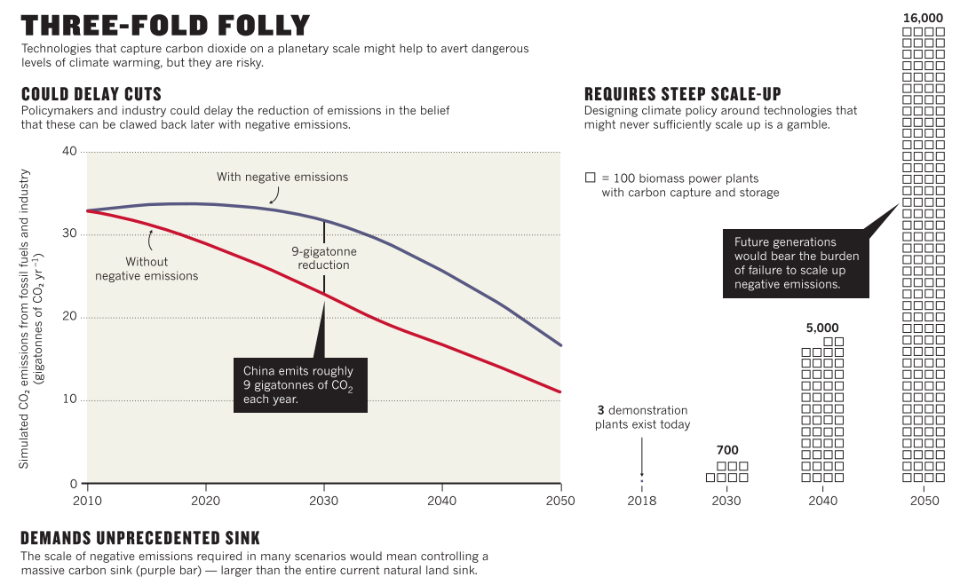
Some journals will overwrite all your work!

Slide 5

Workflow

Slide 6


Figures as an iterative process
Create

Slide 7

Figures as an iterative process
Create
Discuss

Slide 8
Figures as an iterative process
Create
Discuss

Slide 9

Figures as an iterative process
Create
Enhance
Discuss

Slide 10
Inkscape

Slide 11
Why use Inkscape?
Sharpen your message and enhance readibility more efficiently
  Find right figure layout
  Annotate, add guiding lines …
  Combine and scale multiple figures
Create high-quality conceptual figures

Slide 12

What is Inkscape?
„Inkscape is professional quality vector graphics software which runs on Linux, Mac OS X and Windows desktop computers.“
.svg
.pdf
.eps
.bmp
.png
.jpeg

Slide 13
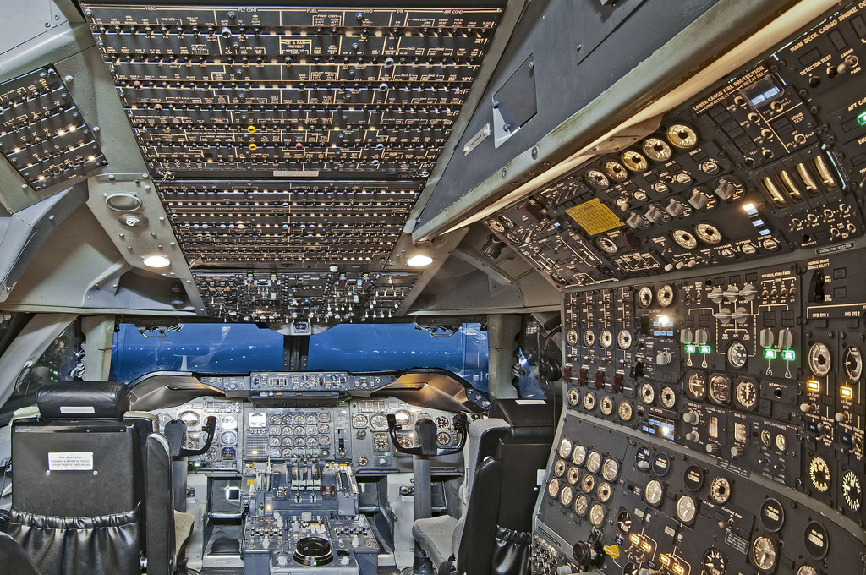

Slide 14
The 7 most useful Inkscape functions
Create objects (e.g. lines, paths, rectangles, circles)
Modify objects (e.g. scale, rotate, flip, reshape)
Align and arrange objects
Format objects (e.g. colour, line style)
Resize document
Export PNG images
Convert images to vector graphics

Slide 15

The 7 most useful Inkscape functions
Create objects (e.g. lines, paths, rectangles, circles)
Modify objects (e.g. scale, rotate, flip, reshape)
Align and arrange objects
Format objects (e.g. colour, line style)
Resize document
Export PNG images
Convert images to vector graphics

Slide 16
Examples?

Slide 17
Workflow & reproducibility

Slide 18
Additional warning
Be VERY careful when editing figure axes in Inkscape!
For complex figures, separate into editable/un-editable components

Slide 19
Learning from past mistakes
?
What did I do?
When?
?
Create
Enhance
Discuss

Slide 20

Github for version control and sharing
Create
Enhance
Track changes
Discuss

Slide 21
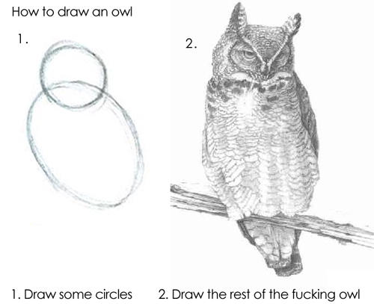
Science: advanced mode
http://plain-text.co/
https://kieranhealy.org/publications/workflow-apps/
http://flyranch.github.io/figurefirst/

Slide 22
Thanks
& please add to our resources:
Articles and papers
Example figures
Books
https://github.com/mcc-apsis/figures/tree/master/Resources

